Slide 1
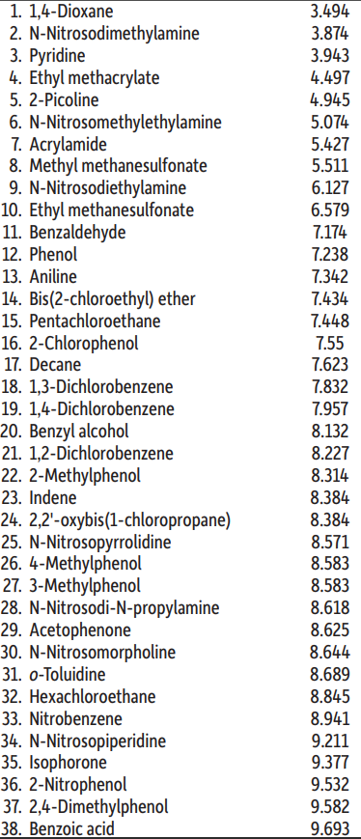
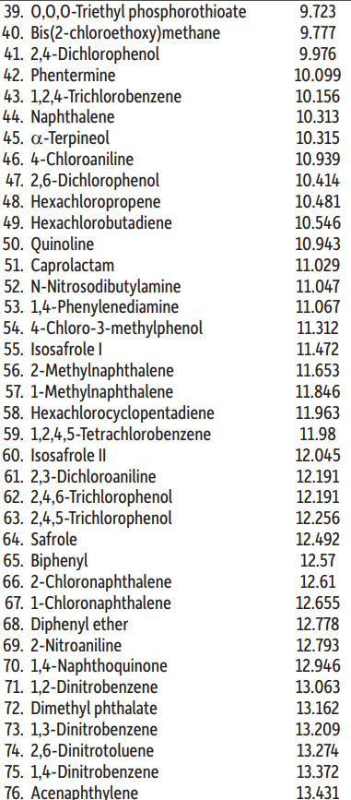
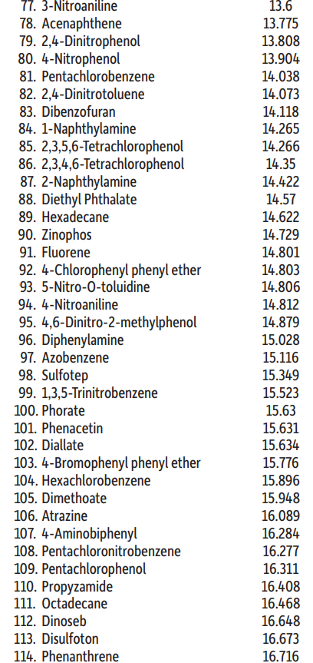
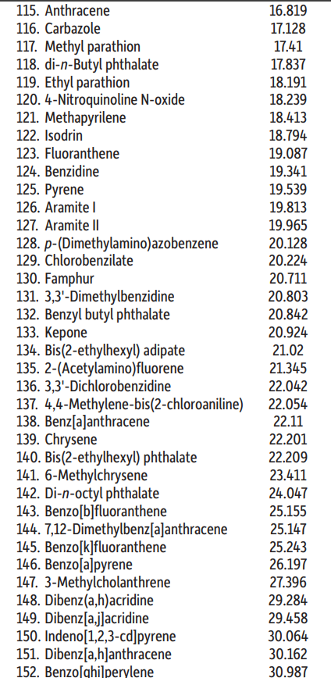
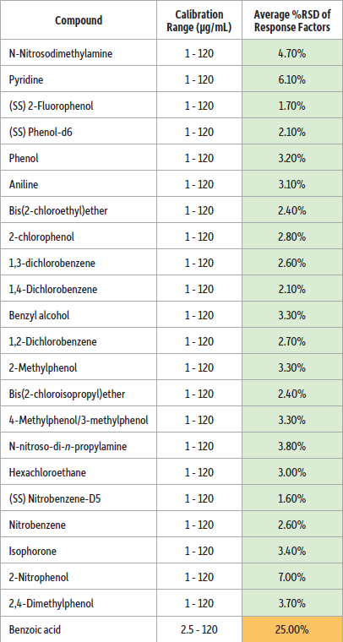
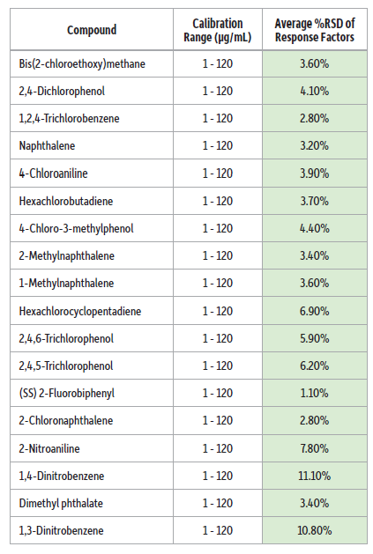
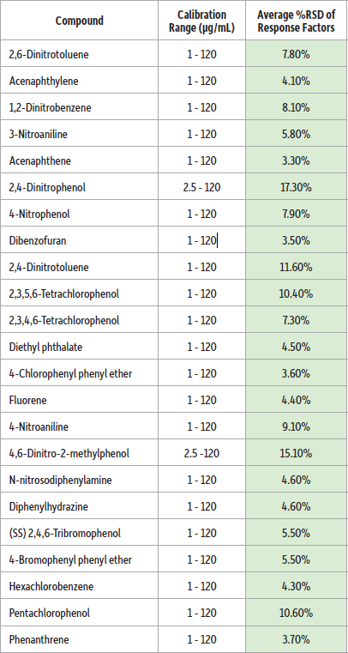
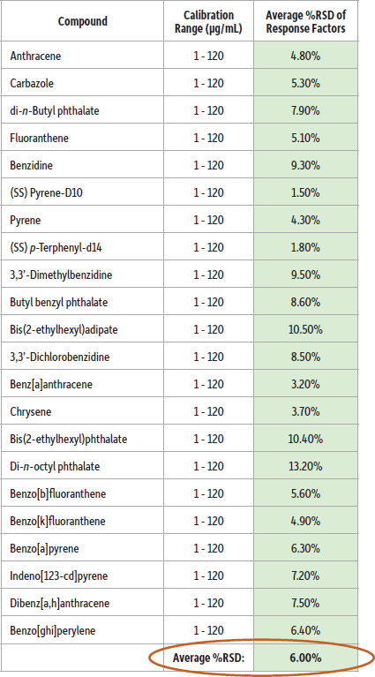

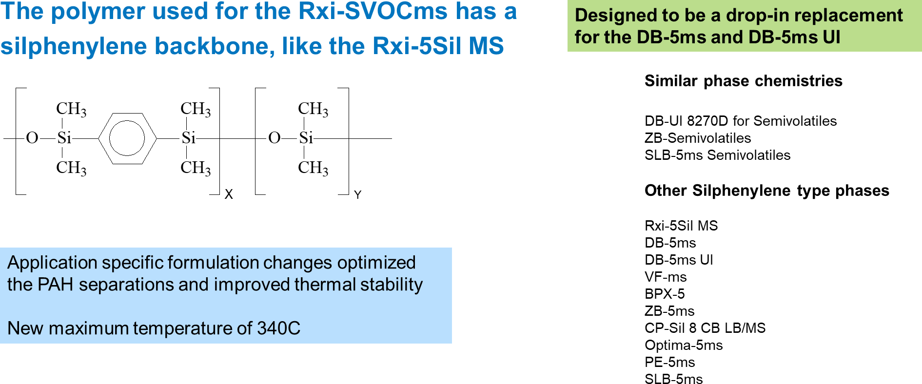
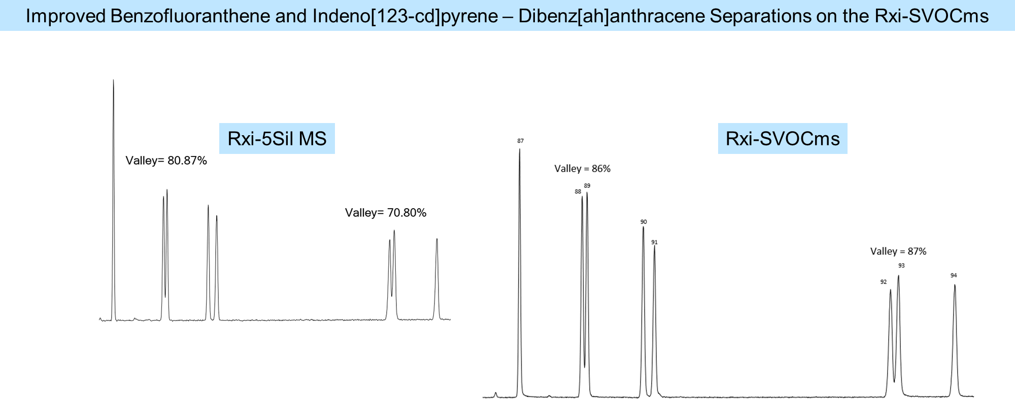
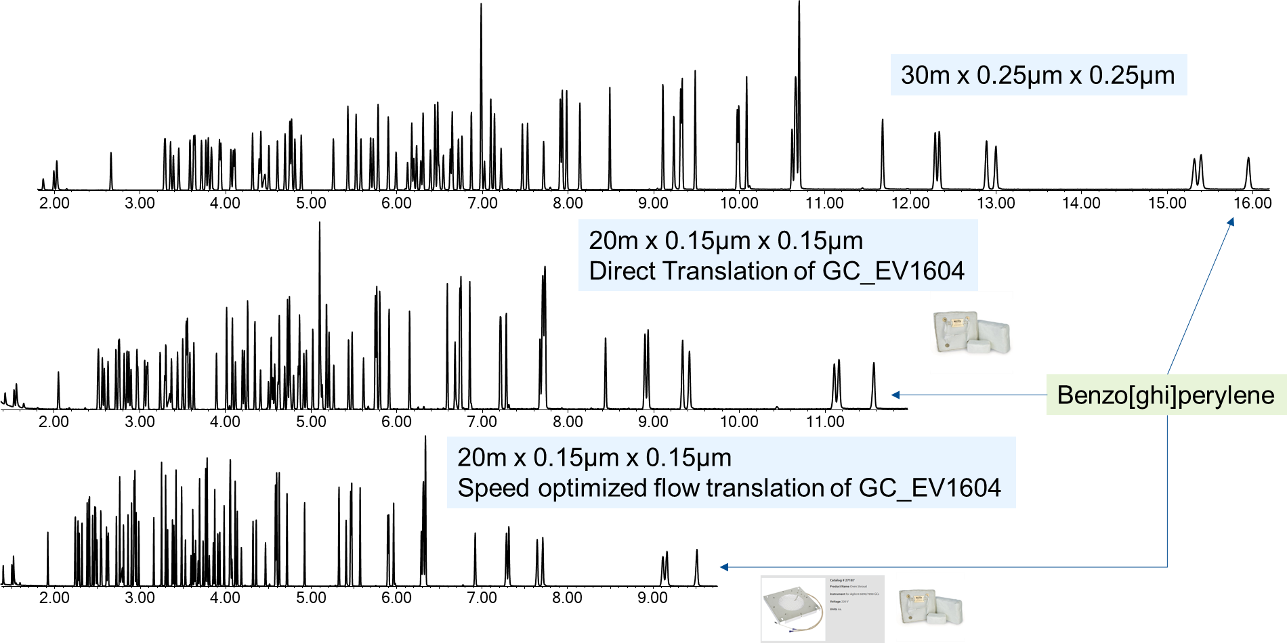
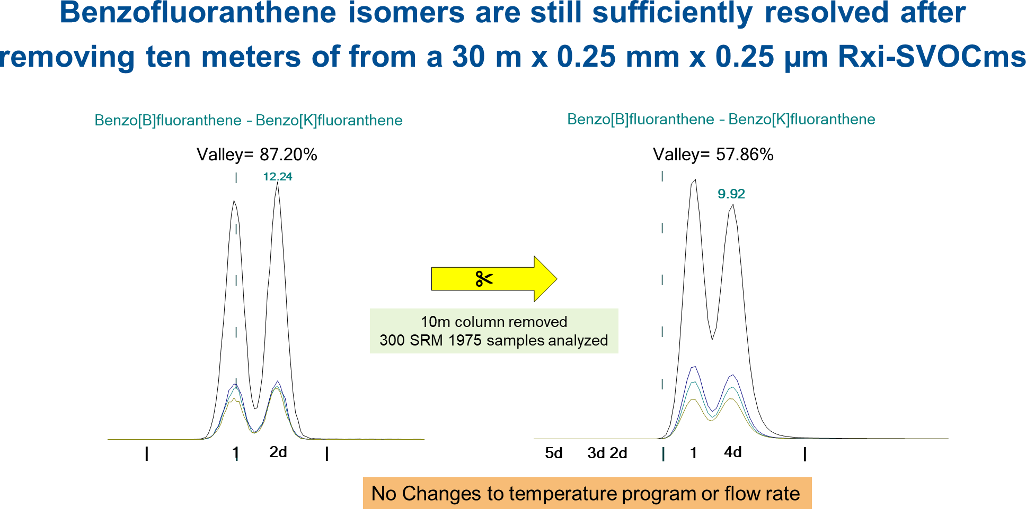
Exploring a New Capillary Gas Chromatography Column in the Analysis of Semivolatiles and Polyaromatic Hydrocarbons
Jessi Collier, Jana Hepner, Erica Pack, Ramkumar Dhandapani, Kristi Sellers, Whitney Dudek-Salisbury, Scott Adams, Jaap de Zeeuw, & Chris English
Restek Corporation, 110 Benner Circle, Bellefonte, PA 16823, United States
Outline
The US Environmental Protection Agency developed a method for the analysis of Semivolatiles using gas chromatography. This allows the determination of on-column amounts of target compounds to be detected at orders of magnitude lower concentrations than conventional single quadrupole mass spectrometers. New column requirements include enhanced robustness, thermal stability, improved PAH selectivity and extended lifetime following highly contaminated extracts.
This presentation will show the dynamic range of this column type with smaller internal diameters in the analysis of semivolatiles and polyaromatic hydrocarbons.
Semi-Volatile Analysis
91,92,93,94
44,45
58,59
61,62
84,85
100,101,102
60
66
107,108,109
139,140
65
90
23,24
45,46
56
67
78,79
89
111
14,15
48,49
68,69
114
25,26,27
57
88
112,113
16
22
28,29
47
76
96
115
123
Enhanced SVOC Performance
38,39
55
75
83
99
118
125
103
19
73
82
98
134
138
13
18
30,31
43
51,52,53
81
86
97
116
143,144
21
37
50
72
87
110
133
12
20
36
42
64
104
120
122
129
132
136,137
17
35
41
63
Surface Deactivation
Polymer
3
5
11
32
40
54
106
119
141
33
74
121
124
128
131
142
New Surface Deactivation:
Improved Inertness
Enhanced Ruggedness
New Polymer:
Optimized PAH Selectivity
Increased Thermal Stability
New Manufacturing Process:
Fused Silica • Consistant Product Performance
4
71
77
105
117
135
145
146
10
70
80
95
127
147
150
152
1
8
9
34
126
130
148
149
151
2
7
6
Polyimide
4.00
6.00
8.00
10.00
12.00
14.00
16.00
18.00
20.00
22.00
24.00
26.00
28.00
30.00
32.00
Inertness = Linear Calibrations
Average %RSDs for 6 Rxi-SVOCms columns (16623) calibrated from 1 ng/µL to 120 ng/µL
Benzoic Acid is the only compound > 20% RSD
0.032 ng 8270 MegaMix on the
Rxi-SVOCms 20 m x 0.15 mm x 0.15 µm
New Polymer
Benz[a]anthracene
Chrysene
Ion 276.00
Valley = 77.7%
Ion 278.00
Benzidine
Ion 252.00
Benzo[k]fluoranthene
Ion 228.00
Benzo[b]fluoranthene
Ion 265.80
Ion 184.00
Dibenz[ah]anthracene
Pentachlorophenol
Indeno[123-cd]pyrene
Optimized PAH Selectivity
Valley = 60.24%
4.00
4.50
5.00
5.50
6.00
6.50
7.00
7.50
8.00
8.50
9.00
Fast GC Method Translation Preserves Elution Profiles

