Slide 1

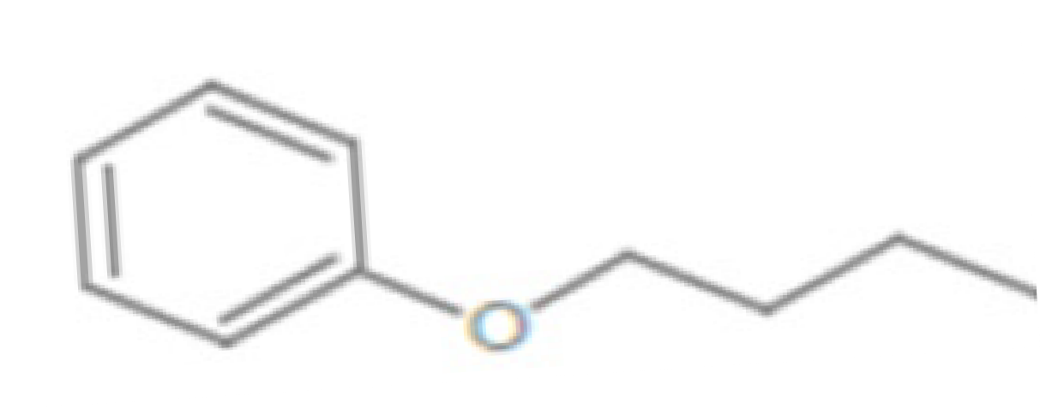
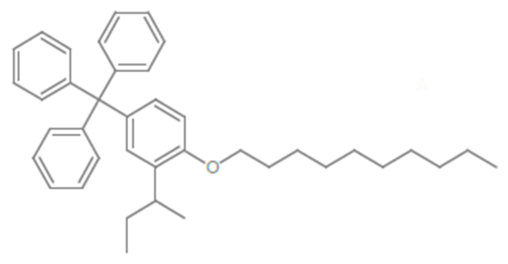
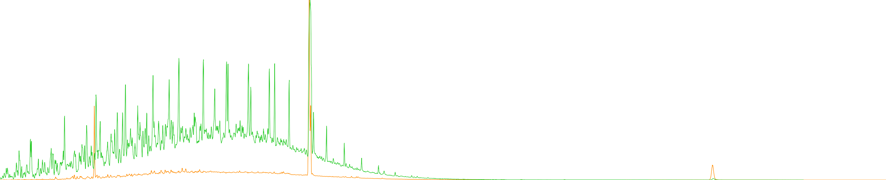



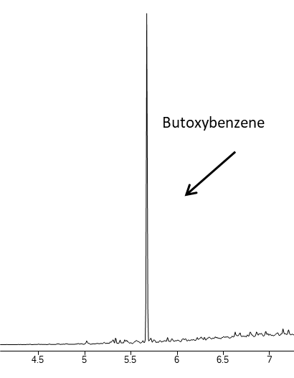
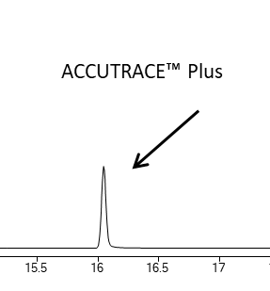
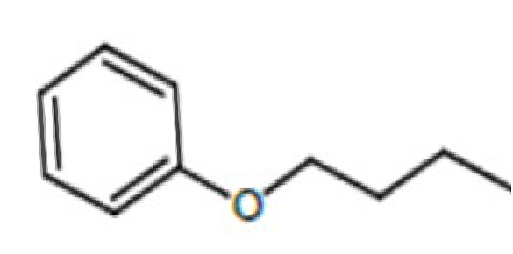
One-dimensional Gas Chromatographic Analysis of European Union Fiscal Fuel Markers
Jessi Collier, Hansjoerg Majer, Didier Dupont, Kristi Sellers, Whitney Dudek-Salisbury, Jaap de Zeeuw, Chris English
Restek Corporation, 110 Benner Circle; Bellefonte, PA 16823, USA; jessi.collier@restek.com
Abstract
Fuel laundering is the illegal process of removing chemical markers or dyes from government-subsidized fuel to sell as more expensive and higher-taxed fuel. In some nations, the subsidized fuel is used for agricultural purposes and residential heating, as well as other specific uses. Some methods for removing the chemical markers and dyes include chemical treatment, filtration, and distillation. The illegal laundering of fuel has many negative consequences for the surrounding community, such as the government missing out on the tax revenue to maintain critical public services, the improper disposal of chemical waste contaminating the environment and exposing humans and animals to health risks, and the creation of negative economic after-effects with market distortion.
Countermeasures developed to combat this problem involve the development of a more sophisticated fuel marker which is harder to remove and easier to detect. This presentation details a one-dimensional GC-MS analytical method for identification and quantitation of a commercial fiscal marker and its preferred marker compound.
Butoxybenzene
ACCUTRACE Plus
14 14.5 15 15.5 16
4.5 5 5.5 6 6.5 7 7.5 8 8.5 9 9.5 10 10.5 11 11.5 12 12.5 13 13.5
An overlay of the same diesel matrix spiked sample (figure 3), containing both butoxybenzene and ACCUTRACE™ Plus, at a concentration of 0.25 µg/mL in scan (green) and SIM (orange).
16.5 17 17.5 18 18.5
Introduction
Fuel laundering describes an effort to remove fiscal markers from fuel making it difficult and ineffective for most testing methods. This adulterated fuel (which was obtained at a decreased price) is then sold for a higher price¹. To prevent tax evasion and fraud of subsidized mineral oils and fuels, governments of the European Commission have adopted regulations phasing in a new, commercially-branded fuel marker—the ACCUTRACE™ Plus. This fuel marker is colorless—removing the visual test barrier which fuel launderers evaded—and able to be seen at incredibly low levels— withstanding common marker removal attempts.
The European Commission has adopted this fuel marker at the dosage of 2.5 ppm (2.5 µg/mL) in diesel fuel. ACCUTRACE™ Plus contains butoxybenzene as the preferred marker compound in the detection of this fiscal marker². Fuel marker analysis has been done with two-dimensional GC (2D-GC) analytical methods; however, this application note provides a one-dimensional GC (1D-GC) analysis.
Agilent 7890 GC
Oven | °C/min | Hold (°C) | Hold (min)
 |  | 30 | 5
 | 15 | 165 | 5
 | 15 | 270 | 10
Inlet (Split/Splitless)
Liner | Topaz, Precision Inlet Liner, 4.0 mm x 6.3 x 78.5 (Catalog #: 23305)
Temperature | 250°C
Mode | Split
Split Ratio | 400:1
Analytical Column
Column | Restek Rxi-5MS 30m x 0.25mmID x 0.25µm (Catalog #: 13423)
 | Restek Rtx-200 60m x 0.25mmID x 0.25µm (Catalog #: 15026)
Mode | Constant Flow
Flow | 1 mL/min
Agilent 5975C MSD
Acquisition Mode | SIM
Gain Factor | 1
SIM Ions
m/z | Dwell Time
94 | 75
94.1 | 75
150 | 75
150.1 | 75
Chemicals and Reagents
Analyte | Butoxybenzene
CAS Number | 1126-79-0
Source | Sigma Aldrich
Solvent (Standard Preparation) | Methylene Chloride
Calibration Curve Concentration | 0.075, 0.1, 0.125, 0.15, 0.175, 0.2, 0.225, 0.25, 0.5 µg/mL
Chemicals and Reagents
Butoxybenzene (CAS Number: 1126-79-0) was purchased Sigma Aldrich [St. Louis, MO, USA]. 2-sec-Butyl-1-(decyloxy)-4-tritylbenzene (CAS Number: 1404190-37-9) was purchased from LCG Standards Ehrenstorfer [Teddington, Middlesex, UK]. All solvents were purchased from ThermoFisher Scientific [Waltham, MA, USA]. Unmarked diesel was obtained from a local gas station.
All standards were prepared in methylene chloride. All analyses were operated with helium as the carrier gas. A seven-point calibration curve was prepared for both butoxybenzene and the 2-sec-Butyl-1-(decyloxy)-4-tritylbenzene at the following concentrations: 0.075, 0.1, 0.125, 0.15, 0.2, 0.225, 0.25 µg/mL.
Instruments and Method
An Agilent 7890 gas chromatograph (GC) system with a 7693A autosampler with a split/splitless injector and Restek Rxi-5ms 30m x 0.25mmID x 0.25µm (Catalog #: 13423). A Restek Topaz, precision inlet liner, 4.0 mm x 6.3 x 78.5 was used.
An Agilent 5975 GC/mass spectrometer detector (MSD) with an extractor source, and selected ion monitoring (SIM) mode for m/z 94, 150, 315, 455, 532 at dwell times of 60 milliseconds.
Results and Discussion
The analysis was run with a 400-to-1 split ratio to minimize the amount of diesel reaching the MSD. Dirty matrices can deposit residues in the ion source of the mass spectrometer, affecting its performance and requiring frequent cleaning.
Split injection limits the introduction of such residues, thus reducing maintenance needs and downtime.
A calibration curve which ranged from 0.075 to 0.25 µg/mL to demonstrate the low levels of detection that are possible to reach with a one-dimensional GC approach. In Figure 5 and Figure 6, the linear regression of 0.998 of the method is shown. In Table 2 and Table 3, the calibration accuracy of all calibration points is shown to be below 4%.
Even at the lowest level of calibration (0.075 µg/mL), the signal-to-noise ratio (S/N) remains high. A high S/N allows for the detection of trace levels of analytes that might be present in low concentrations within a sample. It enhances sensitivity, improves quantitative and qualitative accuracy, aids in the reliable identification of compounds, and aids reproducibility.
Conclusion
Fuel laundering is a serious economic, environmental, and safety issue. It undermines legitimate businesses, causes significant tax revenue losses, and poses health and environmental risks. Governments are continuously improving detection technologies, enhancing regulatory measures, and promoting public awareness to combat this illicit activity effectively.
A 1D-GC approach is capable of detecting both butoxybenzene and ACCUTRACE™ Plus at extremely low levels. With this method, both compounds are able to meet regulatory detection limits in under 20 minutes. This method is robust, reliable, and has a high utility in ensuring fuel quality and safety. The established calibration curves demonstrated excellent linearity and all recoveries of calibration curve and matrix replicates were well within 80% - 120%.
Choosing between one-dimensional gas chromatography and two-dimensional gas chromatography depends on the specific requirements of your analysis.
While 2D-GC offers significant advantages in terms of resolving complex mixtures, 1D-GC analyses offer simplicity, cost-effectiveness, variety, and robustness.
Rxi-5ms - 400 split
Name | RT (min) | Area | S/N | Amount (ug/mL) | Calibrated Amount (ug/mL) | Accuracy (%)
Butoxybenzene | 5.669 | 202652 | 210677 | 0.075 | 0.0781 | -3.97
 | 5.669 | 218564 | 561.13 | 0.1 | 0.0969 | 3.20
 | 5.669 | 230214 | 34.36 | 0.125 | 0.1204 | 3.82
 | 5.669 | 246794 | 278425 | 0.15 | 0.1495 | 0.33
 | 5.669 | 272383 | 321341 | 0.2 | 0.1971 | 1.47
 | 5.669 | 290039 | 359070 | 0.225 | 0.23 | -2.17
 | 5.669 | 297606 | 363391 | 0.25 | 0.2441 | 2.42
Rxi-5ms - 50 split
Name | RT (min) | Area | S/N | Amount (ug/mL) | Calibrated Amount (ug/mL) | Accuracy (%)
Accutrace™ Plus | 16.042 | 59259 | 4126.9 | 0.075 | 0.0753 | -0.40
 | 16.042 | 69796 | 2649 | 0.1 | 0.0996 | 0.40
 | 16.042 | 80701 | 5091.4 | 0.125 | 0.1246 | 0.32
 | 16.042 | 92551 | 3843.9 | 0.15 | 0.1519 | -1.25
 | 16.042 | 112823 | 7385.4 | 0.2 | 0.1985 | 0.76
 | 16.042 | 123251 | 11541 | 0.225 | 0.2225 | 1.12
 | 16.042 | 136321 | 6746.7 | 0.25 | 0.2526 | -1.03
ACCUTRACE™ Plus
(2-sec-Butyl-1-(decyloxy)-4-tritylbenzene)
Calibration curve accuracy (in diesel matrix) for butoxybenzene and the ACCUTRACE™ Plus
References
https://www.audit.gov.ie/en/find- report/publications/2016/tackling-fuel- laundering.pdf
https://eur-lex.europa.eu/legal- content/EN/TXT/PDF/?uri=CELEX:32022 D0197
Butoxybenzene
PATENTS & TRADEMARKS
Restek patents and trademarks are the property of Restek Corporation. (See www.restek.com/Patents-Trademarks for full list.) Other trademarks in Restek literature or on its website are the property of their respective owners. Restek registered trademarks are registered in the U.S. and may also be registered in other countries.

