Slide 1
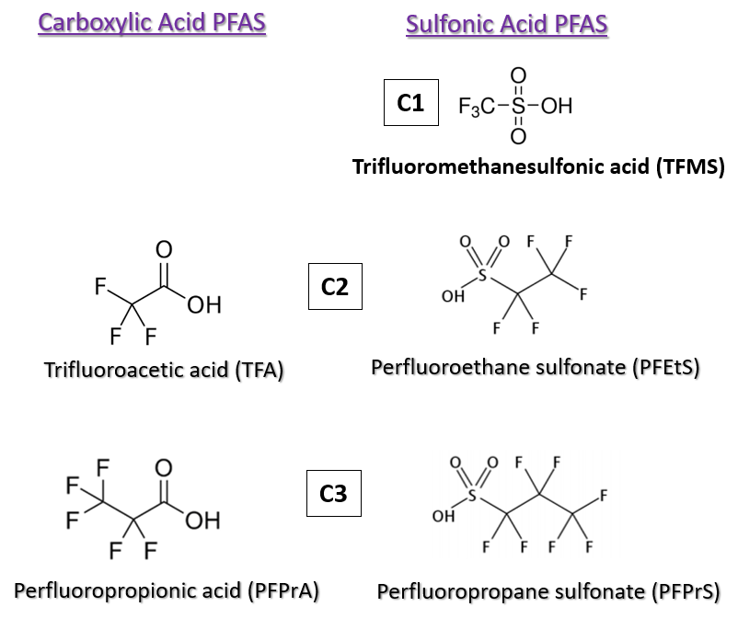
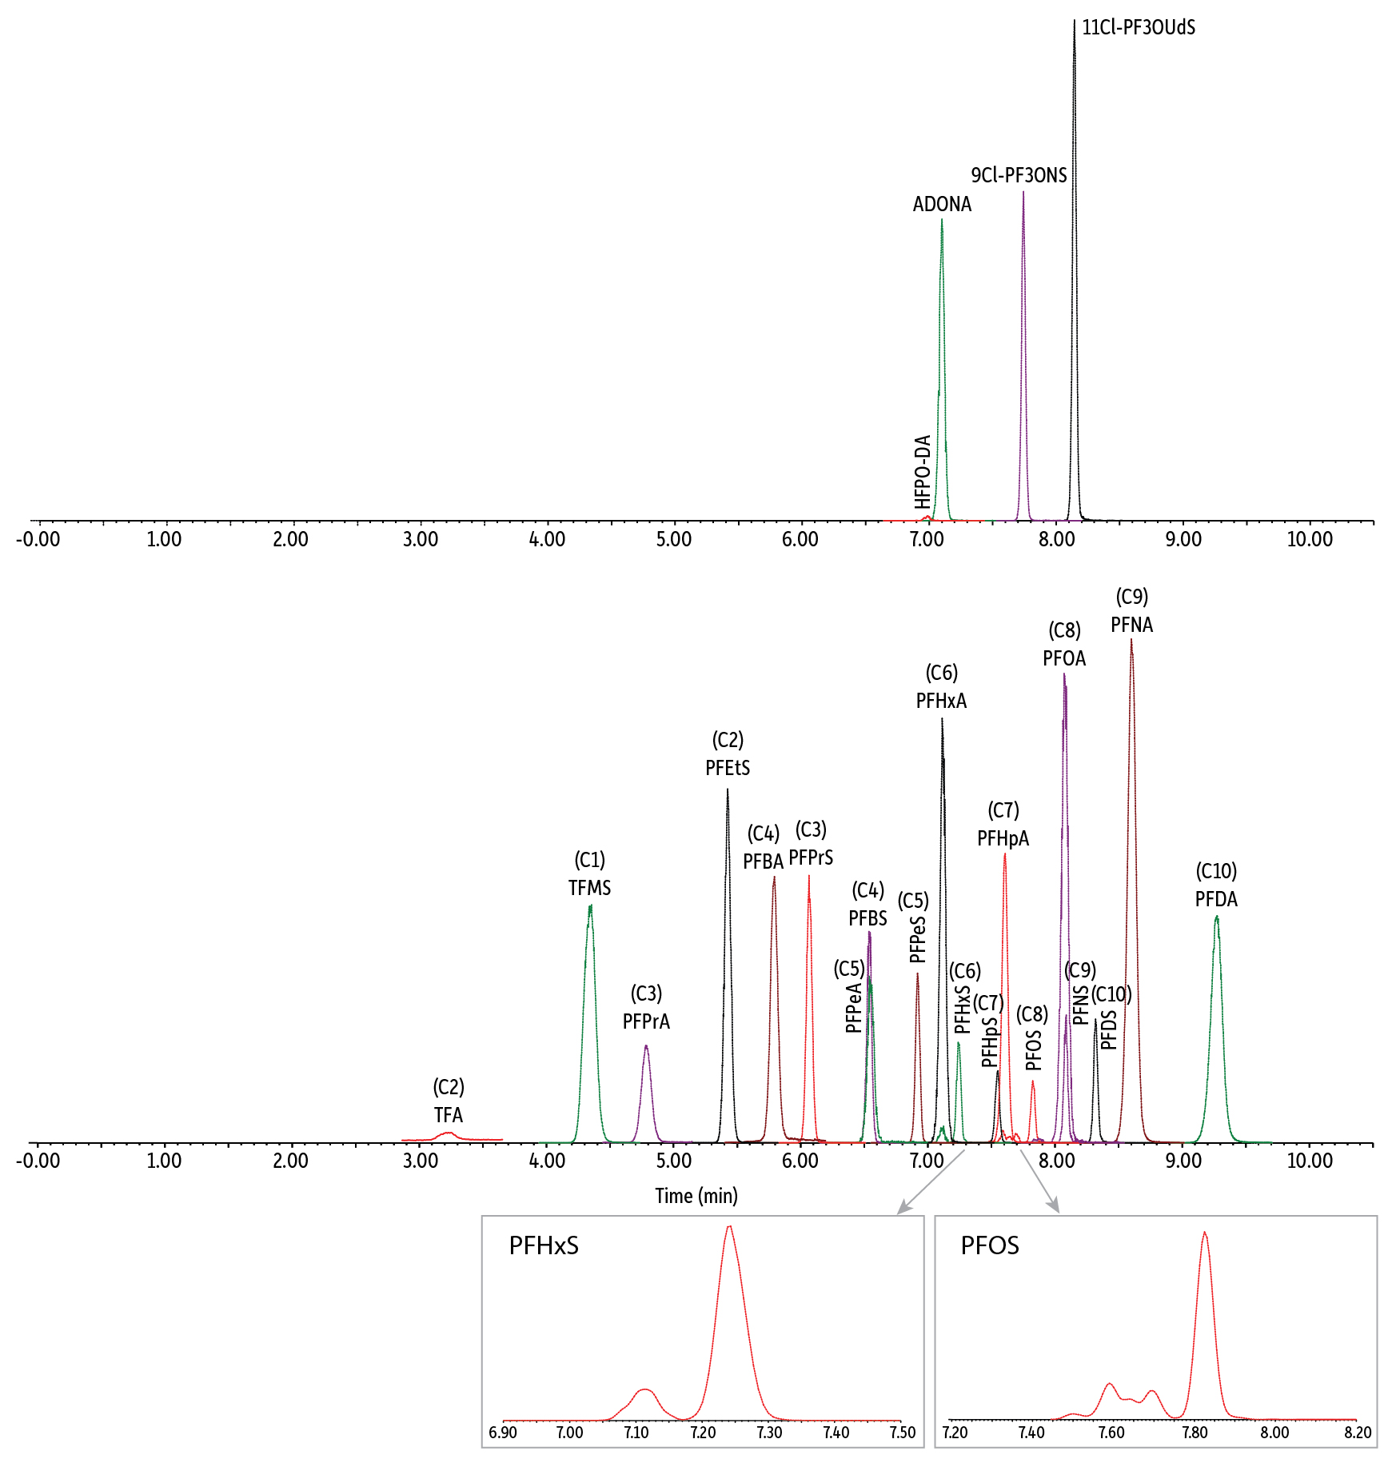
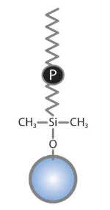
Integration of Ultrashort-Chain Compounds into the Biomonitoring of PFAS in Human Plasma and Serum
Shun-Hsin Liang, Justin Steimling; Restek Corporation
Introduction
Standard and Sample Preparation
Ultrashort-chain (USC) per- and polyfluoroalkyl substances (PFAS) are small and very polar compounds with carbon chain lengths shorter than C4 (Figure 1). Their ubiquitous and high levels of occurrence in environmental aquatic systems have raised significant concern in conjunction with long-chain PFAS contamination. Measuring USC PFAS in blood can not only monitor human exposure but also serves as a valuable tool for studying the potential risks associated with USC PFAS exposure. The high polarity of USC PFAS poses a challenge to current analytical practices based on the reverse-phased liquid chromatography, primarily due to insufficient chromatographic retention. In this study, a simple and reliable workflow was developed for the simultaneous analysis of C1 to C10 perfluoroalkyl carboxylic and sulfonic acids, along with four alternative PFAS, in human plasma and serum. The samples underwent a single-step protein precipitation procedure and were analyzed with a user-friendly LC-MS/MS method, implementing a polar-embedded LC column. Method accuracy and precision were evaluated with fortified fetal bovine serum. The method’s validity was confirmed by accurately measuring targeted PFAS with known concentrations in NIST standard reference human plasma (1950) and serum (1957).
The calibration standard solutions (100 µL) were prepared in the reverse osmosis water, supplemented with 1x phosphate-buffered saline, at the range of 0.05 to 40 ng/mL (ppb) in polypropylene HPLC vials. Five isotopically labeled PFAS were implemented as non-extracted or quantification internal standards (QIS) (see Table 2). A 5 µL aliquot of QIS working solution containing 40 ng/mL of ¹³C₃-PFBA, 20 ng/mL of ¹³C₂-PFHxA and ¹³C₄-PFOA, and 10 ng/mL of ¹³C₅-PFNA and 13C2-PFDA, was added to the standard solution, followed by mixing with 200 µL of methanol containing 1.5% formic acid.
For the assessment of method accuracy and precision, 100 µL of FBS was fortified at 0.4, 2, 10, and 30 ppb with non-labeled analytes and isotopically labeled ¹³C-TFA, which served as a surrogate for the determination of TFA recovery. The fortified FBS was mixed with 5 µL of QIS working solution and 2 µL of extracted internal standard (EIS) working solution containing 50 ng/mL of ¹³C₃₋PFPrA, ¹³C₄-PFBA, ¹³C₅-PFPeA, ¹³C₅-PFHxA, ¹³C₄-PFHpA, ¹³C₈-PFOA, ¹³C₉-PFNA, ¹³C₆-PFDA, ¹³C₃-PFHxS, and ¹³C₈-PFOS. A 200 µL aliquot of methanol containing 1.5% formic acid was then added to fortified FBS followed by vortexing for 30 seconds at 3000 rpm. After centrifugation at 4200 rpm for 10 minutes, approximately 150 µL of supernatant was transferred to a polypropylene vial insert placed in an HPLC vial and subsequently injected for LC-MS/MS analysis. For the analysis of non-fortified human plasma and serum samples, the same procedure for fortified FBS analysis was followed.
Results & Discussion
LC-MS/MS Method Development: A chromatographic method was established (see Table 1) for the analysis of C1 to C10 PFAS (Figure 2). The Ultra IBD column exhibited satisfactory retention for USC PFAS under reverse-phased conditions. More importantly, the extensive retention of USC PFAS, especially for the first-eluted analyte (TFA), led to reduced matrix interferences. The MS/MS transition parameters for each analyte are provided in Table 2.
Linearity: With quadratic regression (1/x weighted), all analytes showed acceptable linearities with r² >0.995 and deviations <20%. Table 3 shows differential linearity ranges of analytes, ranging from 0.05 ppb to 40 ppb, with variation at the lowest calibration concentration.
Accuracy & Precision: Three batches of analyses were conducted on different days, totaling nine repetitions at each fortified level. The averaged recovery and relative standard deviation (RSD) are presented in Table 3. All analytes exhibited recovery values within the range of 82.3 – 115% across three fortification levels. Satisfactory method precision was demonstrated with %RSD values ranging from 1.51 – 11.3%. Additionally, the results indicated that all EIS had recovery values within 20% of the nominal concentration.
Measurement of C1 – C10 and Alternative PFAS in NIST 1950 and 1957: Six preparations of each SRM were subjected to the analysis with the developed LC method. The results indicated that all measured EIS concentrations fell within 20% of the nominal concentration. Moreover, Table 4 illustrates that the averaged experimental concentrations of most PFAS closely matched the reference concentrations, with deviations within 20%. Although the measured PFDA concentration in NIST 1957 exhibited a slightly higher deviation of 26%, it remained within the deviation range of the reference concentration. These results demonstrated that the established method was suitable for accurate measurement of PFAS in both human plasma and serum. In addition to the reference PFAS, other measurable PFAS were also reported in Table 4.
Figure 1: Structures of C1 to C3 PFAS
Figure 2: Chromatogram for the Analysis of a 10 ppb Standard Solution
Table 3: Accuracy & Precision Analysis of Fortified Fetal Bovine Serum
 |  |  | Average Recovery (RSD, %)
 | Linearity Range | LOD | Fortified Concentration (ng/mL)
Analytes | (ng/mL) | (ng/mL) | 0.4 | 2 | 10 | 30
¹³C-TFA | 0.50 - 40 | 0.1250* | - | 90.6 (9.28) | 98.0 (2.99) | 100 (10.7)
PFPrA | 0.25 - 40 | 0.0102 | 108 (2.53) | 115 (0.965) | 105 (6.99) | -
PFBA | 0.10 - 40 | 0.0222 | 104 (5.57) | 109 (1.75) | 104 (1.51) | -
PFPeA | 0.10 - 40 | 0.0125 | 97.4 (3.25) | 93.3 (4.19) | 89.1 (5.57) | -
PFHxA | 0.10 - 40 | 0.0098 | 99.2 (2.46) | 109 (4.65) | 102 (6.31) | -
PFHpA | 0.10 - 40 | 0.0050 | 86.7 (5.37) | 99.2 (2.04) | 89.2 (1.80) | -
PFOA | 0.10 - 40 | 0.0051 | 94.8 (8.24) | 107 (5.30) | 95.6 (3.35) | -
PFNA | 0.10 - 40 | 0.0012 | 96.2 (1.44) | 111 (1.87) | 99.1 (2.62) | -
PFDA | 0.10 - 40 | 0.0083 | 93.6 (1.93) | 102 (2.03) | 95.5 (3.64) | -
TFMS | 0.05 - 40 | 0.0070 | 89.4 (7.33) | 88.8 (3.80) | 91.9 (3.19) | -
PFEtS | 0.05 - 40 | 0.0020 | 98.0 (2.62) | 103 (1.47) | 99.3 (2.26) | -
PFPrS | 0.05 - 40 | 0.0030 | 98.1 (8.18) | 108 (4.23) | 98.9 (4.15) | -
PFBS | 0.05 - 40 | 0.0124 | 88.0 (8.84) | 94.1 (4.95) | 86.5 (6.17) | -
PFPeS | 0.10 - 40 | 0.0031 | 94.8 (4.57) | 100 (8.05) | 94.3 (5.43) | -
PFHxS | 0.10 - 40 | 0.0115 | 85.8 (7.88) | 96.0 (10.0) | 92.2 (8.98) | -
PFHpS | 0.10 - 40 | 0.0088 | 92.5 (6.75) | 99.8 (6.45) | 93.4 (5.74) | -
PFOS | 0.10 - 40 | 0.0200 | 97.8 (8.66) | 97.9 (7.01) | 95.9 (3.37) | -
PFNS | 0.10 - 40 | 0.0129 | 92.1 (7.98) | 94.2 (4.43) | 91.9 (2.78) | -
PFDS | 0.10 - 40 | 0.0111 | 92.6 (8.20) | 82.3 (3.48) | 87.6 (3.55) | -
HFPO-DA | 0.50 - 40 | 0.1875 | - | 99.9 (11.3) | 91.1 (8.95) | 90.4 (6.13)
ADONA | 0.10 - 40 | 0.0035 | 90.4 (7.14) | 106 (4.67) | 95.7 (4.25) | -
9Cl-PF3ONS | 0.10 - 40 | 0.0031 | 95.8 (4.20) | 93.7 (5.12) | 93.8 (6.71) | -
11Cl-PF3OUdS | 0.10 - 40 | 0.0023 | 106 (5.10) | 84.5 (4.20) | 97.2 (4.86) | -
* For non-labeled TFA
Methods
Table 1: Analytical Conditions (Waters Xevo TQ-S with Acquity UPLC)
Analytical Column | Ultra IBD 100 mm x 2.1 mm, 3 µm (Restek Cat.# 9175312)
Delay Column | PFAS Delay Column (Restek Cat.# 27854)
Mobile Phase A | 5 mM ammonium formate, 0.1% formic acid in water
Mobile Phase B | Acetonitrile
Gradient | Time (min) | %B
 | 0.00 | 20
 | 7.00 | 95
 | 9.00 | 95
 | 9.01 | 20
 | 11.00 | 20
Flow Rate | 0.3 mL/min
Injection Volume | 5 µL
Column Temp. | 40°C
Ion Mode | Scheduled MRM with negative ESI
Table 4: The Quantification of PFAS in NIST 1950 and 1957
 | Reference | Experimental | Experimental | Concentration
 | Concentration | Avg. Concentration | Precision | Ratio
Analytes | (ng/mL) | (ng/mL) | (%RSD) | (%)
 | NIST 1950
PFOA | 3.27 ± 0.06 | 3.12 | 3.70 | 95.4
PFNA | 0.720 ± 0.028 | 0.85 | 0.74 | 117
PFDA | 0.322 ± 0.007 | 0.30 | 3.47 | 91.6
PFHxS | 3.25 ± 0.08 | 2.91 | 6.26 | 89.5
PFOS | 10.64 ± 0.13 | 12.57 | 2.92 | 118
TFA | - | 5.74 | 4.45 | -
PFPrA | - | 0.26 | 6.90 | -
PFHpA | - | 0.23 | 3.04 | -
TFMS | - | 0.08 | 3.95 | -
PFPeS | - | 0.15 | 4.31 | -
PFHpS | - | 0.36 | 4.90 | -
PFDS | - | 0.10 | 4.64 | -
 | NIST 1957*
PFHpA | 0.305 ± 0.051 | 0.28 | 2.16 | 92.1
PFOA | 5.00 ± 0.44 | 4.21 | 1.91 | 84.2
PFNA | 0.878 ± 0.077 | 0.77 | 1.38 | 87.9
PFDA | 0.39 ± 0.12 | 0.29 | 2.69 | 74.4
PFHxS | 4.00 ± 0.83 | 3.35 | 9.88 | 83.8
PFOS | 21.1 ± 1.3 | 20.46 | 3.81 | 97.0
TFA | - | 3.22 | 3.79 | -
TFMS | - | 0.07 | 0.10 | -
PFPeS | - | 0.10 | 7.97 | -
PFHpS | - | 0.48 | 6.20 | -
PFDS | - | 0.10 | 4.23 | -
* The reference concentration for NIST 1957 is present as mass fraction (µg/kg)
Table 2: MS Transitions and Analytes Retention Times
Compounds | Retention | Precusor Ion | Product ions* | Cone (V) | Collision (V) | Quantification
 | Time (min) |  |  |  |  | Internal Standard
Target Analytes
TFA | 3.25 | 113.03 [M-H]- | 69.01 | 10 | 10 | ¹³C₃-PFBA
PFPrA | 4.81 | 162.97 [M-H]- | 119.02 | 10 | 8 | ¹³C₃-PFBA
PFBA | 5.80 | 213.03 [M-H]- | 168.98 | 14 | 8 | ¹³C₃-PFBA
PFPeA | 6.56 | 262.97 [M-H]- | 218.97 | 2 | 6 | ¹³C₂-PFHxA
PFHxA | 7.13 | 313.10 [M-H]- | 268.97/118.99 | 2 | 8/20 | ¹³C₂-PFHxA
PFHpA | 7.62 | 363.16 [M-H]- | 319.09/169.06 | 8 | 10/18 | ¹³C₄-PFOA
PFOA | 8.10 | 413.10 [M-H]- | 368.96/168.90 | 2 | 10/16 | ¹³C₄-PFOA
PFNA | 8.62 | 463.10 [M-H]- | 419.01/219.02 | 4 | 10/16 | ¹³C₅-PFNA
PFDA | 9.29 | 513.17 [M-H]- | 469.16/219.06 | 4 | 12/16 | ¹³C₂-PFDA
TFMS | 4.37 | 148.97 [M-H]- | 79.93/98.92 | 62 | 18/18 | ¹³C₃-PFBA
PFEtS | 5.44 | 198.90 [M-H]- | 79.92/98.91 | 38 | 22/22 | ¹³C₃-PFBA
PFPrS | 6.08 | 248.97 [M-H]- | 79.92/98.91 | 2 | 24/24 | ¹³C₃-PFBA
PFBS | 6.55 | 298.97 [M-H]- | 79.97/98.89 | 2 | 26/26 | ¹³C₂-PFHxA
PFPeS | 6.93 | 349.10 [M-H]- | 79.98/98.98 | 6 | 32/30 | ¹³C₂-PFHxA
PFHxS | 7.24 | 398.90 [M-H]- | 79.97/98.89 | 56 | 32/34 | ¹³C₂-PFHxA
PFHpS | 7.56 | 449.17 [M-H]- | 79.98/98.97 | 4 | 42/38 | ¹³C₂-PFHxA
PFOS | 7.82 | 499.03 [M-H]- | 79.92/98.90 | 8 | 40/40 | ¹³C₄-PFOA
PFNS | 8.09 | 549.10 [M-H]- | 79.92/98.83 | 12 | 42/40 | ¹³C₄-PFOA
PFDS | 8.32 | 599.17 [M-H]- | 79.98/98.83 | 8 | 44/46 | ¹³C₅-PFNA
HFPO-DA | 7.01 | 285.03 [M-COOH]- | 169.02/185.02 | 2 | 6/16 | ¹³C₂-PFHxA
ADONA | 7.11 | 376.90 [M-H]- | 250.93/84.97 | 22 | 12/26 | ¹³C₂-PFHxA
9Cl-PF3ONS | 7.75 | 530.78 [M-H]- | 350.85/82.96 | 12 | 26/24 | ¹³C₂-PFHxA
11Cl-PF3OUdS | 8.15 | 630.78 [M-H]- | 450.80/82.95 | 8 | 26/32 | ¹³C₅-PFNA
Extracted Internal Standards
¹³C-TFA | 3.25 | 114.03 [M-H]- | 69.03 | 10 | 8 | ¹³C₃-PFBA
¹³C₃-PFPrA | 4.81 | 165.97 [M-H]- | 120.96 | 10 | 11 | ¹³C₃-PFBA
¹³C₄-PFBA | 5.80 | 217.03 [M-H]- | 171.98 | 2 | 8 | ¹³C₃-PFBA
¹³C₅-PFPeA | 6.56 | 267.97 [M-H]- | 222.99 | 2 | 6 | ¹³C₂-PFHxA
¹³C₅-PFHxA | 7.13 | 318.03 [M-H]- | 272.93 | 2 | 7 | ¹³C₂-PFHxA
¹³C₄-PFHpA | 7.62 | 366.90 [M-H]- | 321.93 | 2 | 10 | ¹³C₄-PFOA
¹³C₈-PFOA | 8.10 | 420.97 [M-H]- | 375.94 | 2 | 10 | ¹³C₄-PFOA
¹³C₉-PFNA | 8.62 | 471.97 [M-H]- | 426.87 | 4 | 8 | ¹³C₅-PFNA
¹³C₆-PFDA | 9.29 | 518.90 [M-H]- | 473.87 | 4 | 13 | ¹³C₂-PFDA
¹³C₃-PFHxS | 7.24 | 401.90 [M-H]- | 79.97 | 2 | 32 | ¹³C₂-PFHxA
¹³C₈-PFOS | 7.82 | 506.84 [M-H]- | 79.97 | 4 | 48 | ¹³C₄-PFOA
Non-Extracted Internal Standards
¹³C₃-PFBA | 5.80 | 215.97 [M-H]- | 171.97 | 10 | 8
¹³C₂-PFHxA | 7.13 | 314.97 [M-H]- | 269.93 | 8 | 8
¹³C₄-PFOA | 8.10 | 416.87 [M-H]- | 371.88 | 2 | 8
¹³C₅-PFNA | 8.62 | 467.87 [M-H]- | 422.89 | 16 | 10
¹³C₂-PFDA | 9.29 | 514.87 [M-H]- | 469.84 | 8 | 10
* Quantifier Ion/Qualifier Ion
Plasma and Serum Samples
Charcoal-stripped fetal bovine serum (FBS) obtained from MilliporeSigma (Burlington, MA) was utilized for method validation due to its absence of all analytes of interest with the exception of TFA. Subsequently, a TFA isotope, 13C-TFA, was employed as a surrogate to assess the method accuracy for TFA in FBS. NIST SRM 1950 metabolites in human plasma and NIST SRM 1957 organic contaminants in non-fortified human serum were purchased from NIST Store (Gaithersburg, MD). These SRMs are characterized by known concentrations of six or seven short-chain and long-chain PFAS.
Conclusions
A simple and reliable workflow was established in this study to provide a unique solution for the integration of ultrashort-chain compounds into the measurement of PFAS in human plasma and serum. The reported method was rugged, accurate, and precise by implementing a polar-embedded column for chromatographic analysis. Most importantly, this solution can offer a valuable tool for gaining insights into human exposure to these emergent ultrashort-chain PFAS.
PATENTS & TRADEMARKS Restek patents and trademarks are the property of Restek Corporation. (See www.restek.com/Patents-Trademarks for full list.) Other trademarks in Restek literature or on its website are the property of their respective owners. Restek registered trademarks are registered in the U.S. and may also be registered in other countries.

