Slide 1
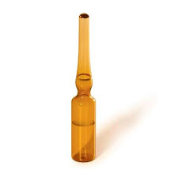
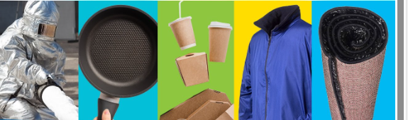
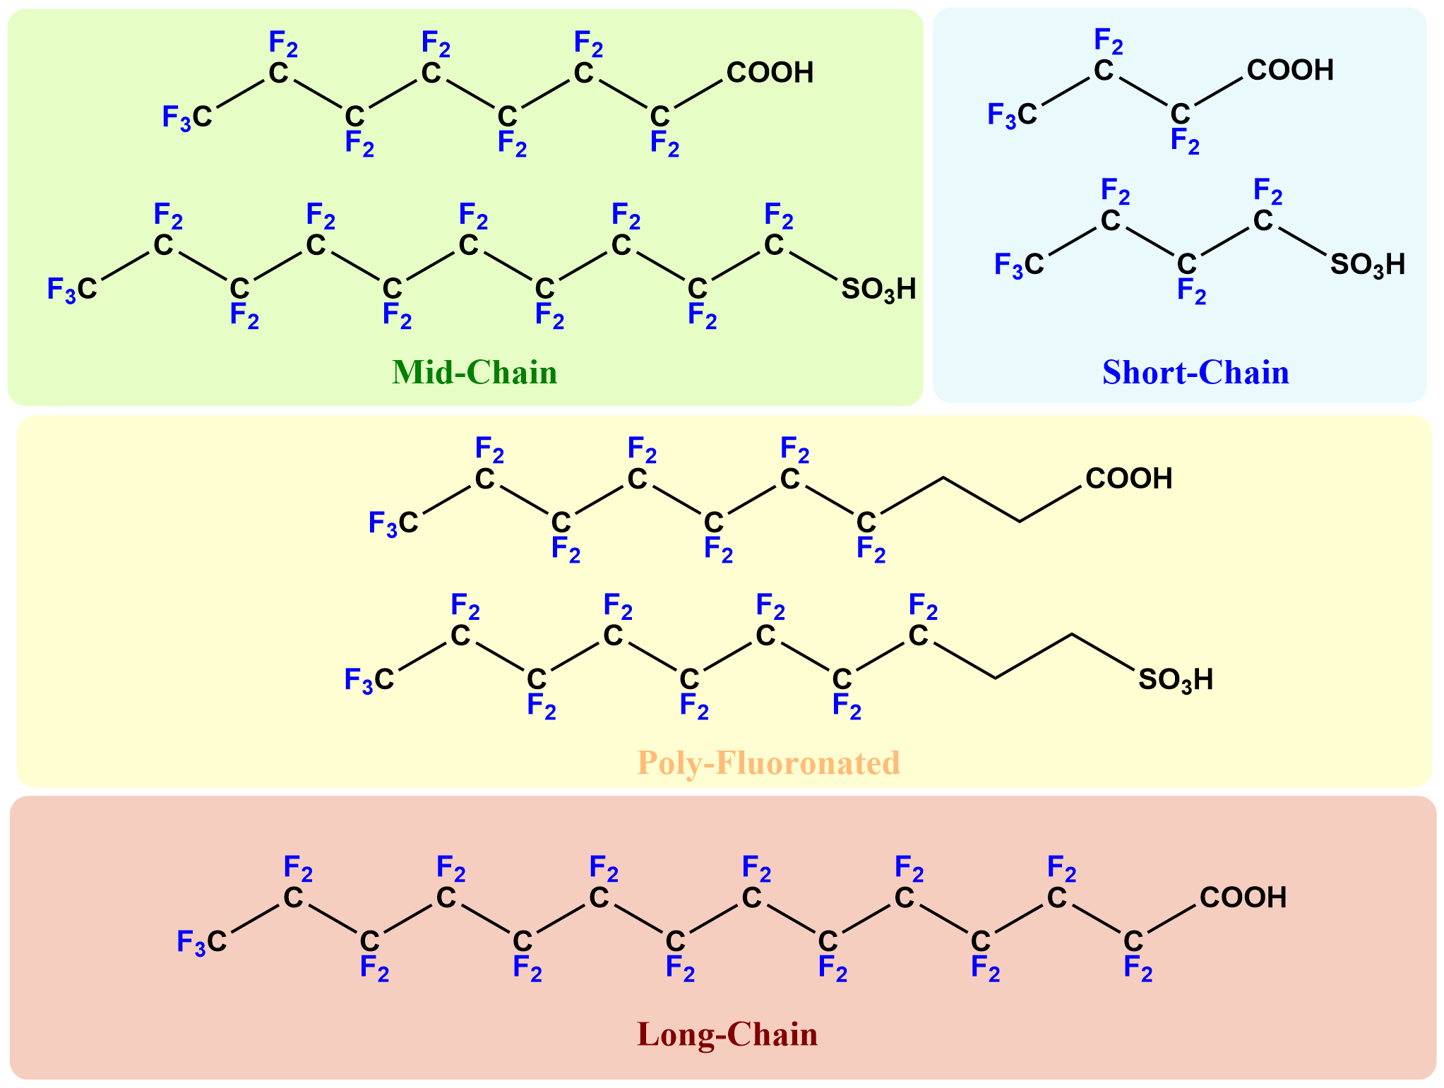
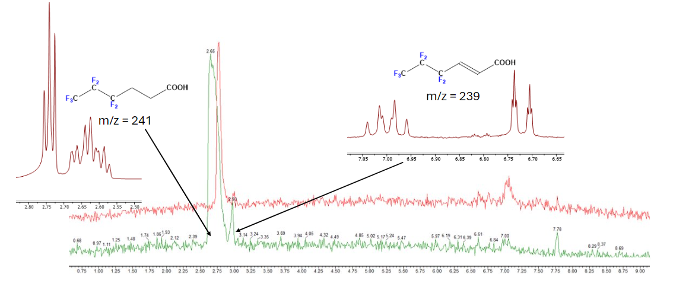
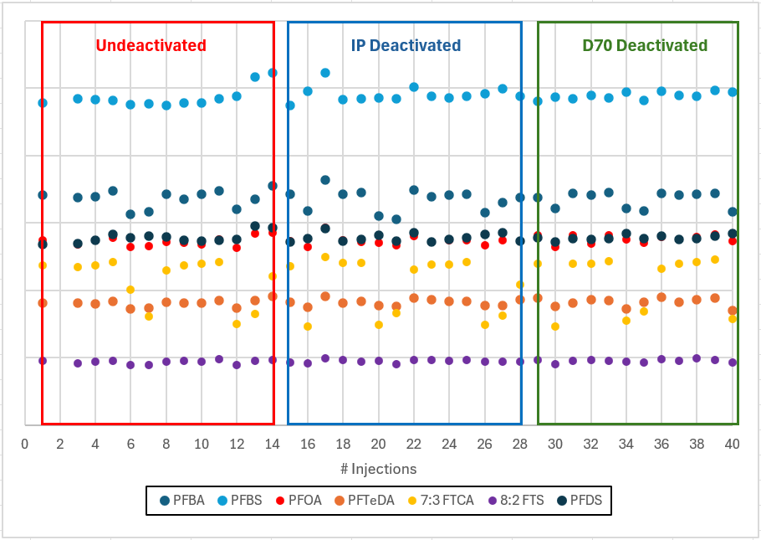
PFAS Feasibility: Determination of Glass Deactivation and Stabilizer Concentration
Kendra Jozefick, Grayson Ritch, Anyssa Coverston
Restek Corporation, Bellefonte, PA
Introduction
Sample Preparation
Results (cont.)
PFAS (per- and polyfluoroalkyl substances) are a class of synthetic organofluorine chemicals that have been used in consumer and industrial products since the 1950s. They are persistent in the environment and have been classified as an emerging contaminant by the EPA. Customers need a complete solution for testing these compounds which includes reference standards. Our Reference Standards New Product group is looking to offer a comprehensive PFAS standards program starting with four new PFAS reference standard singles. Part of the new product process is looking into the feasibility of the proposed new product to help determine a stable formulation and procedure. In this experiment, the focus was the following:
The role glassware deactivation plays in preventing analyte adsorption onto the glassware.
The effect a stabilizer at varying concentrations in methanol has on preventing degradation of PFAS compounds.
PFAS compounds with varying chain lengths and functional groups were selected to effectively represent the wide variety of PFAS compounds currently being tested.
1000 ppm PFAS Stock Solution*
in MeOH/IPA (80:20)
 | 5-Day Stability at 10°C
 | PFBA | PFBS | PFOA | 7:3 FTCA | 8:2 FTS | PFDS | PFTeDA
No Stabilizer | 94.12 | 90.88 | 93.11 | 94.69 | 94.19 | 93.09 | 94.92
0.01mM NaOH | 100.00 | 100.00 | 100.00 | 100.00 | 100.00 | 100.00 | 100.00
0.1mM NaOH | 94.22 | 92.41 | 93.79 | 96.34 | 97.23 | 93.73 | 94.89
1mM NaOH | 95.07 | 92.70 | 92.79 | 96.71 | 95.50 | 94.62 | 95.65
0.01mM KOH | 93.24 | 93.32 | 93.08 | 95.69 | 97.33 | 93.19 | 96.90
0.1mM KOH | 94.02 | 92.88 | 93.72 | 95.70 | 96.84 | 94.53 | 95.63
1mM KOH | 94.34 | 93.31 | 93.74 | 97.29 | 98.11 | 95.32 | 95.90
 | 5-Day Stability at 40°C
 | PFBA | PFBS | PFOA | 7:3 FTCA | 8:2 FTS | PFDS | PFTeDA
No Stabilizer | 87.25 | 94.70 | 90.26 | 58.87 | 92.18 | 94.84 | 91.53
0.01mM NaOH | 85.29 | 92.82 | 92.35 | 59.90 | 95.65 | 96.68 | 92.78
0.1mM NaOH | 84.09 | 92.65 | 91.31 | 66.88 | 91.47 | 93.70 | 92.16
1mM NaOH | 95.81 | 95.88 | 95.66 | 92.74 | 98.11 | 98.08 | 98.40
0.01mM KOH | 86.58 | 94.06 | 91.33 | 59.76 | 94.98 | 97.14 | 92.62
0.1mM KOH | 90.82 | 95.51 | 93.78 | 65.29 | 94.70 | 98.09 | 92.90
1mM KOH | 92.95 | 93.34 | 93.16 | 83.51 | 94.94 | 93.64 | 97.14
Add 100 µL
1 mM Stabilizer Stock Solution**
NaOH or KOH in MeOH
For 1 mM → add 900 µL
For 0.1 mM → add 90 µL
For 0.01 mM → add 9 µL
100 ppm
PFAS Working Solution
in MeOH/IPA (98:2)
1000 ppm PFAS Stock Solution in MeOH/IPA (80:20)
Methanol
For 1 mM stabilizer → none added
For 0.1 mM stabilizer → add 810 µL
For 0.01 mM stabilizer → add 891 µL
Compound | Synonym | CAS #
Perfluorobutanoic acid | PFBA | 375-22-4
Potassium Perfluorobutanesulfonate | PFBS | 29420-49-3
Perfluorooctanoic acid | PFOA | 335-67-1
3-Perfluoroheptyl propanoic acid | 7:3 FTCA | 812-70-4
Sodium 1H,1H,2H,2H-Perfluorodecane sulfonate | 8:2 FTS | 27619-96-1
Sodium Perfluorodecanesulfonate | PFDS | 2806-15-7
Perfluorotetradecanoic acid | PFTeDA | 376-06-7
PFOA
PFBA
PFDS
PFBS
*The longer chain length PFAS compounds were not fully soluble in MeOH. IPA was added to the PFAS stock solution for solubility purposes.
**Stabilizer stocks contain 0.1% water for solubility
Table III: % Recovery showing the effect NaOH and KOH at varying concentrations in MeOH have on preventing degradation of the 100 ppm PFAS Working Solution after 5 days at 10°C and 40°C. % recovery data is normalized to the largest response. Yellow indicates the value is outside of 10% criteria, red indicates outside of 20% criteria.
7:3 FTCA
A follow-up study was done to observe if there were any differences in % recovery between prepping a select group of PFAS compounds with varying water/MeOH ratios in polypropylene vials compared to undeactivated glass vials. To accomplish this, a new high concentration stock solution containing PFBA, PFOA, PFTeDA, and PFDS was diluted down in IPA and combined with varying ratios of water and MeOH, resulting in 100, 0.01, and 0.001 ppm concentrations of the PFAS compounds. These solutions were prepped in both polypropylene and undeactivated glass vials and tested immediately.
8:2 FTS
Analytical Method
PFTeDA
Autosampler Temp: | 10°C
Injection Volume | 3 µL
Column: | Force C18 1.8µM, 50 x 2.1mm (catalogue #: 9634252)
Column Temp: | 40°C
MP A: | 0.5mM ammonium acetate in water
MP B: | MeOH
Flow: | 0.4 mL/min
Detector: | For Scan Data: Scan 50-850m/z, ES-, 0.6s scan time
Gradient: | For MRM Data |  | For Scan Data
 | Time (mins) | % A | Time (mins) | % A
 | 0 | 20 | 0 | 20
 | 6 | 5 | 6 | 5
 | 8.5 | 5 | 13.5 | 5
 | 8.51 | 20 | 13.51 | 20
 | 9.5 | 20 | 18.5 | 20
Table I: 1000 ppm PFAS Stock Solution Compound List and Structures, Solvent: MeOH/IPA (80:20)
Background
 | Polypropylene Vials |  |  |  |  | Glass Vials
 | 100 ppm
% Water | PFBA | PFOA | PFDS | PFTeDA |  | PFBA | PFOA | PFDS | PFTeDA
100 | 77.91 | 100.46 | 86.42 | 113.17 |  | 79.65 | 101.8 | 89.7 | 116.4
80 | 77.3 | 101.3 | 92.4 | 102.28 |  | 79.42 | 101.56 | 82.44 | 103.85
50 | 80 | 99.32 | 97.13 | 92.18 |  | 82.57 | 103.13 | 102.07 | 93.59
20 | 86.86 | 97.49 | 94.8 | 93.48 |  | 89.07 | 100.38 | 99.42 | 97.23
 | 0.01 ppm (10 ppb)
% Water | PFBA | PFOA | PFDS | PFTeDA |  | PFBA | PFOA | PFDS | PFTeDA
100 | 46.67 | 48.8 | 25.94 | 17.33 |  | 51.23 | 55.36 | 40.5 | 18.29
80 | 56.04 | 61.86 | 31.79 | 10.7 |  | 59.83 | 63.56 | 56.49 | 40.95
50 | 74.69 | 82.24 | 85.05 | 79.22 |  | 74.53 | 77.25 | 95.31 | 84.63
20 | 88.03 | 96.72 | 101.25 | 96.76 |  | 90.5 | 95.79 | 61.39 | 59.08
 | 0.001 ppm (1 ppb)
% Water | PFBA | PFOA | PFDS | PFTeDA |  | PFBA | PFOA | PFDS | PFTeDA
100 | 19.52 | 11.69 | 5.03 | 26.16 |  | 21.04 | 14 | 6.68 | 9.44
80 | 33.14 | 31 | 16.92 | 20.68 |  | 33.12 | 30 | 30.3 | 33.43
50 | 58.91 | 56.62 | 60.24 | 55.62 |  | 57.64 | 57.3 | 35.17 | 30.91
20 | 84.16 | 83.51 | 72.57 | 84.92 |  | * | * | * | *
PFAS compounds have been known to adsorb to glass surfaces, especially in the presence of water, which can affect the concentration of the analyte in the solution. The deactivation process creates an inert surface on the glassware that prevents reactions between the glassware and the analytes. Two deactivation methods used at Restek are IP and D70 deactivation. IP deactivation, while sufficient for most analytes, leaves some unreacted silanol groups on the glass surface, which can react with sensitive analytes and cause analyte retention. D70 deactivation addresses this issue by depositing a more inert, rugged, and stable deactivated layer on the surface of the glass than the IP deactivation. In this experiment, we tested the percent recovery of seven PFAS compounds using un-deactivated, IP deactivated, and D70 deactivated glass vials.
Many of the PFAS compounds contain a carboxylic or sulfonic acid functional group and are therefore prone to decomposition by dehydrogenation or transesterification in MeOH solvent. Adding a base stabilizer such as NaOH or KOH may help prevent these reactions and increase the stability of the solutions. We tested two bases, NaOH and KOH, at varying concentrations to see their effect on compound stability at standard and stressed temperatures.
Table II: LC-MS/MS method conditions. The 100 ppm data was acquired using a single quad MS2 scan. The 10 ppb and 1 ppb data was acquired using a triple quad MRM.
Results
Table IV: % Recovery of select PFAS compounds at specified concentrations with varying ratios of water/MeOH diluent for polypropylene and glass vials. % Recovery was normalized to the 100% MeOH responses. Green indicates the value is above 10% criteria, yellow indicates within 10-20% criteria.
Conclusions and Recommendations
Figure I: Dehydrogenation of the parent compound 3:3 FTCA (CAS 356-02-5) to 2H,3H-Heptafluorohexenoic acid (CAS 356-03-6)
During this study, it was observed that the vial deactivation had little or no effect on the stability and recovery of the 7 PFAS compounds tested during the 5-day period. IP deactivated glassware is standard for current reference standards; therefore, IP deactivated glassware will be used for our new PFAS reference standards.
For the majority of the PFAS compounds, when NaOH and KOH stabilizers were added to the solutions, an increase in % recovery was observed when compared to solutions with no stabilizer added. At standard storage conditions of 10°C, these were all within our 10% specifications. The positive effect of the stabilizers on compound stability is most apparent at the stressed conditions of 40°C. The stability was also compound dependent with the largest difference seen with 7:3 FTCA and PFBA. The data suggests that 1mM NaOH is the optimal stabilizer and concentration, being the most effective at preventing compound degradation. Using MeOH preserved with 1mM NaOH and a 2% 2-Propanol co-solvent for solubility would be our recommendation for the final solvent for our new PFAS reference standard solutions.
In the follow up study comparing polypropylene vials with undeactivated glass vials, there was no notable difference in % recovery of the tested PFAS compounds between polypropylene vials and glass vials for 100 ppm PFAS solutions. At lower concentrations, there was a significant decrease in % recovery correlating with increased % water in the samples for both vial types. For labs that are testing at the 10 ppb or 1 ppb level and using a diluent with high water content, or storing solutions for a longer time, vial type should be a consideration since the effects become more relevant at lower PFAS concentrations.
Experimental Design
Test Period
Storage Conditions
Diluent
Stabilizer Concentration
Stabilizers
Vial Type
5 Days
10°C (refrigerator) and 40°C (heater block)
MeOH/IPA (98:2)
NaOH and KOH
0.01 mM, 0.1 mM, and 1 mM in MeOH
Un-deactivated, IP deactivated, and D70 deactivated glass
Figure 2: Results of individual compound responses from the 100 ppm PFAS Working Solution stored in un-deactivated, IP deactivated, and D70 deactivated glass for 5 days
Notes:
fluorotelomer carboxylic acids (FTCAs)
IP deactivation leaves some unreacted silanol groups on the glass surface, which can react with sensitive analytes and cause analyte retention.
D70 results in a more inert surface and is more rugged and stable than the IP deactivation
D70 reagents bond to the glass surface, crosslink, and provide a barrier to keep metal ions in the glass from interacting with analytes. Barrier also eliminates analyte retention by eliminating their diffusion into the deactivant film. The D70 process uses 2 deactivants; the first is more volatile and reacts primarily with the silanol groups on the glass surface, the second is less volatile and crosslinks residuals left from #1

